Slide 1
Kubernetes
Notes:
https://courses.cs.washington.edu/courses/cse403/13au/lectures/git.ppt.pdf
http://enos.itcollege.ee/~jpoial/allalaadimised/git/getting-started-with-git.pdf

Slide 2
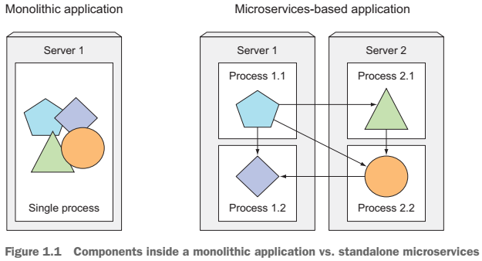

Slide 3
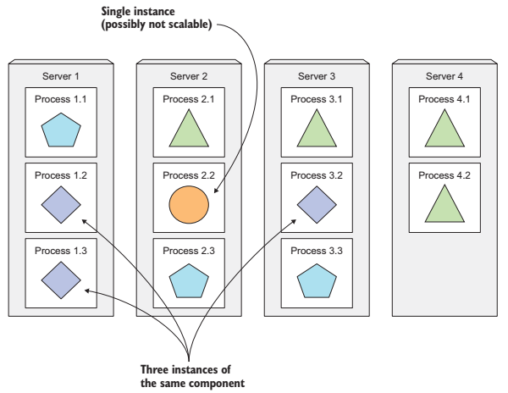

Slide 4
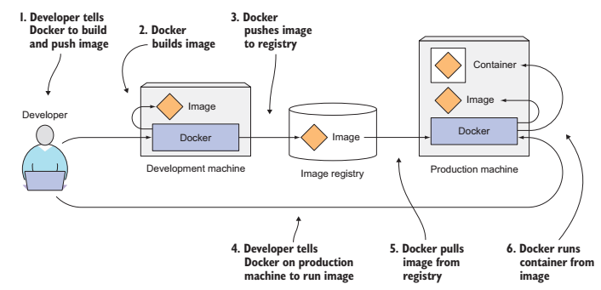

Slide 5
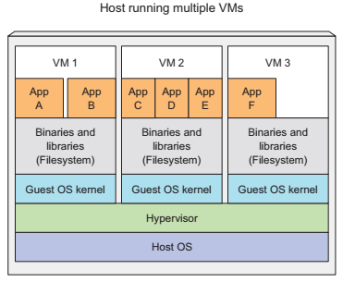
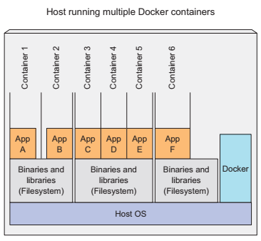

Slide 6
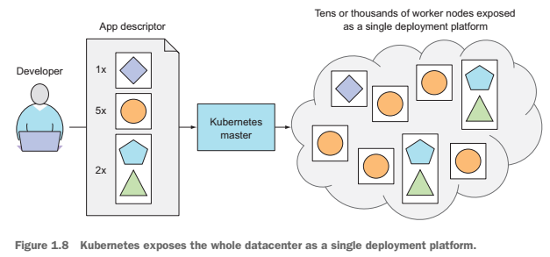

Slide 7
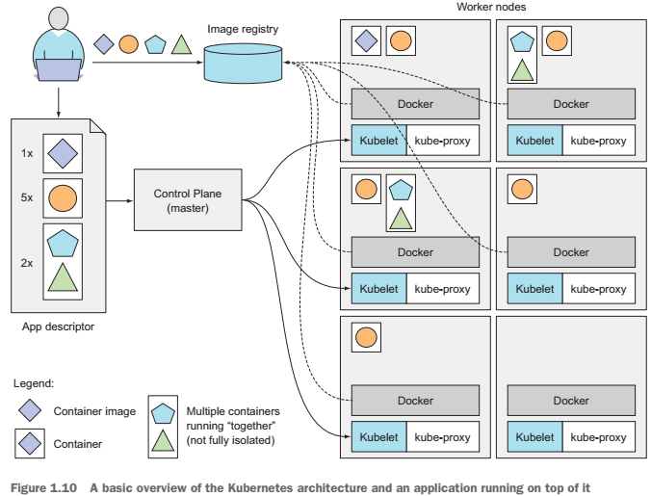

Slide 8
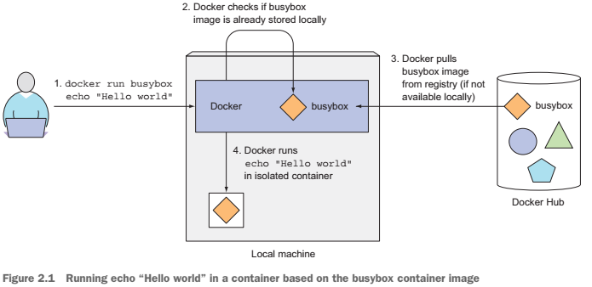

Slide 9
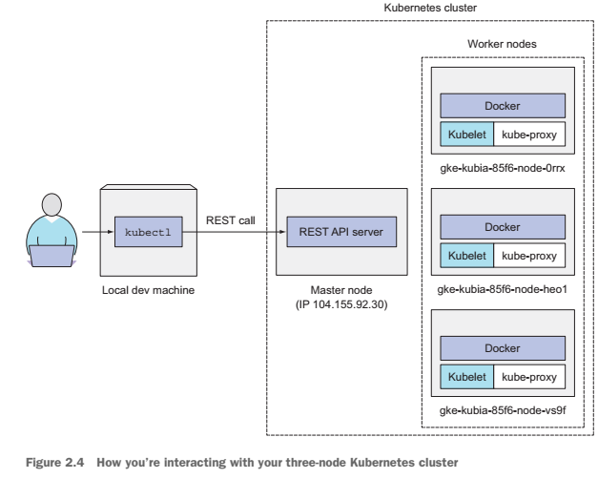

Slide 10
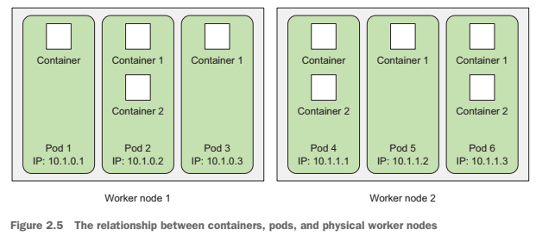

Slide 11
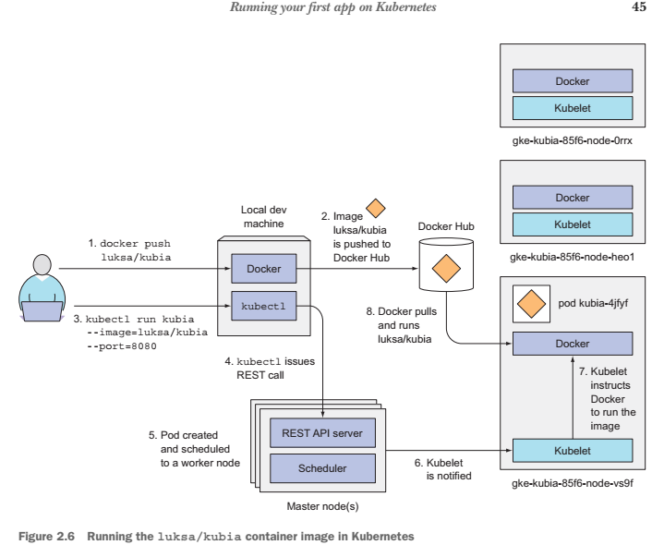

Slide 12
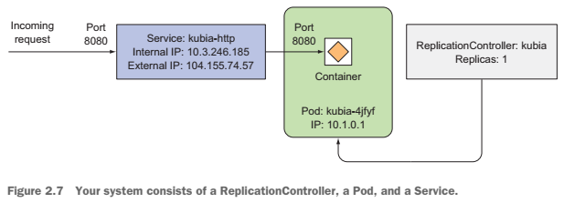

Slide 13
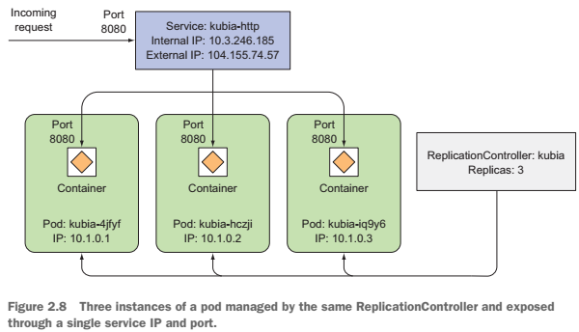

Slide 14
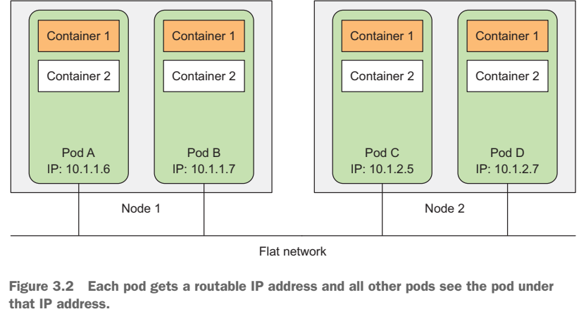

Slide 15
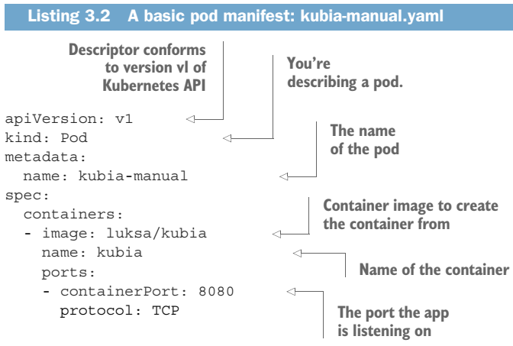

Slide 16
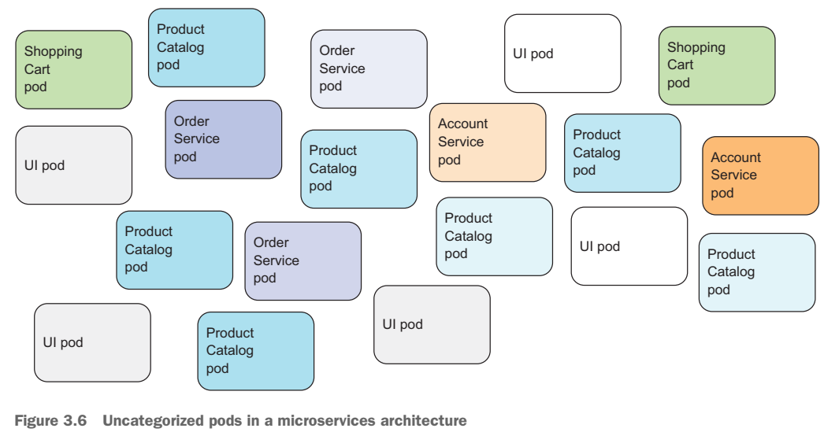

Slide 17
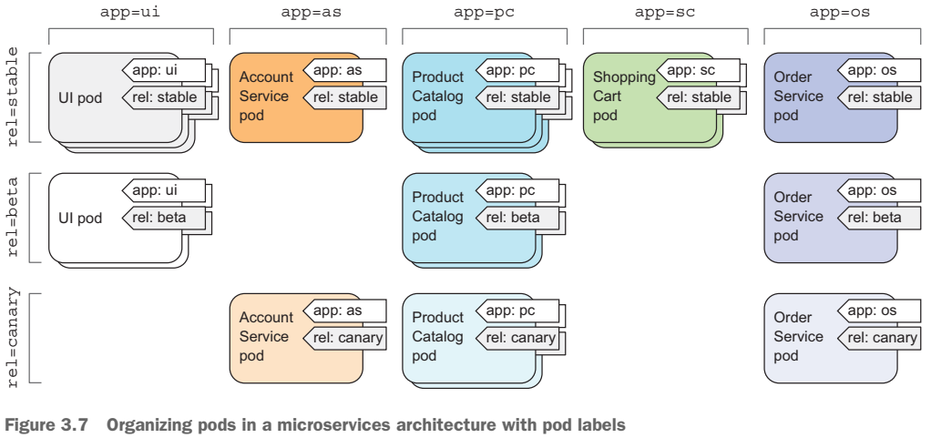

Slide 18
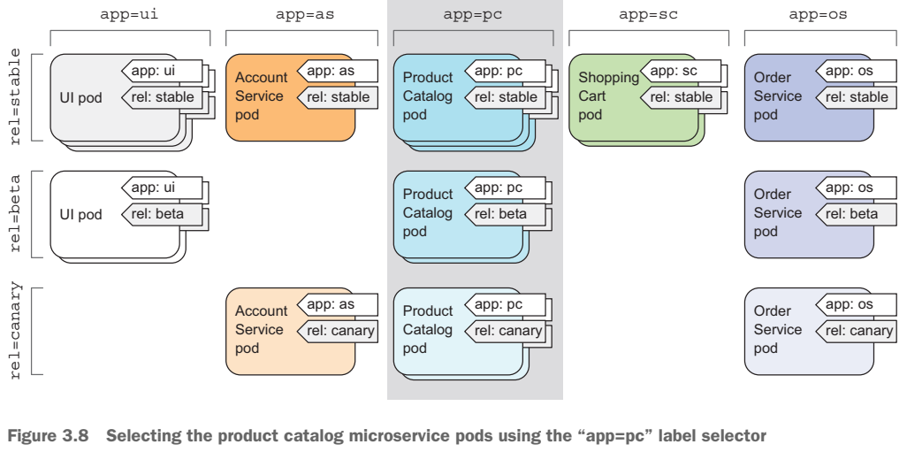

Slide 19
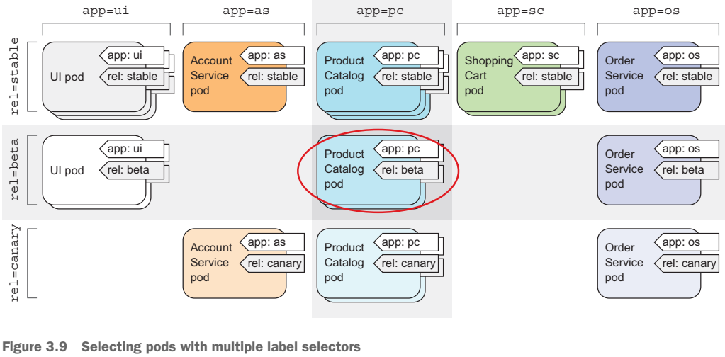

Slide 20
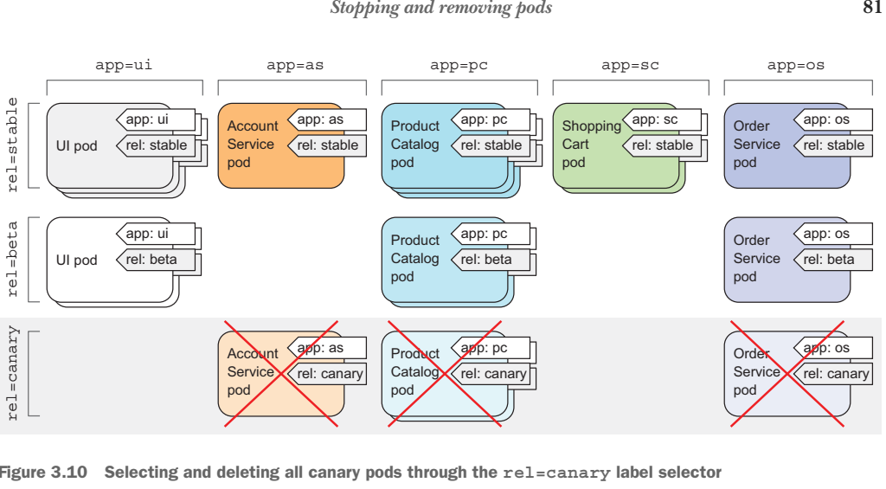

Slide 21
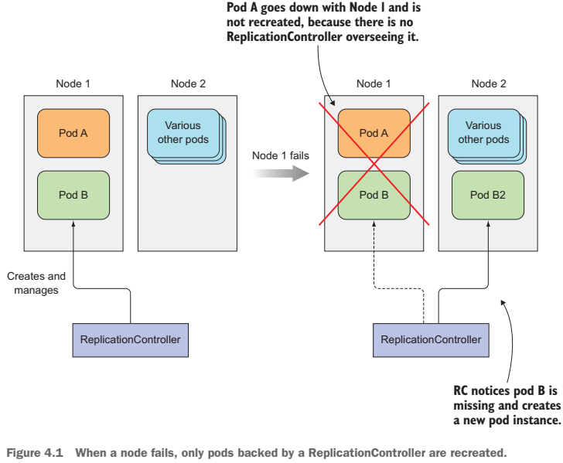

Slide 22
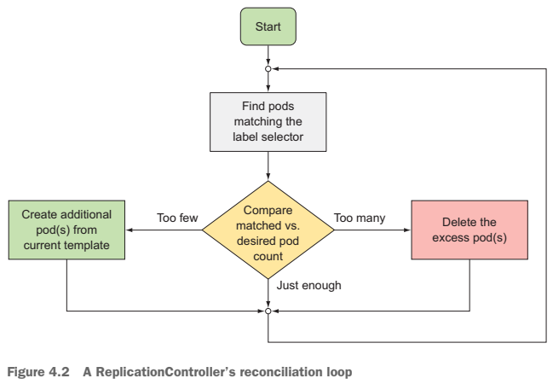

Slide 23
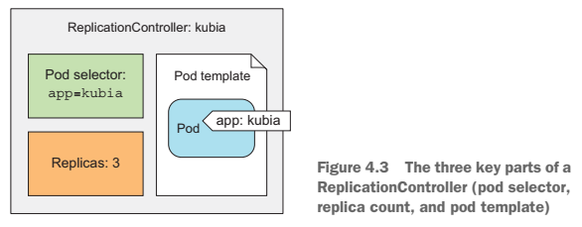

Slide 24
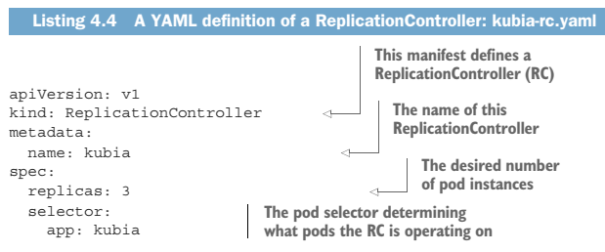
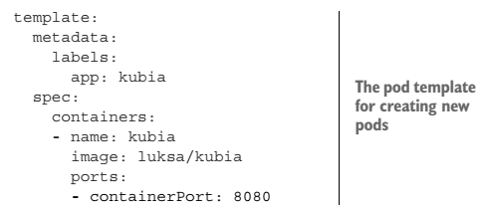

Slide 25
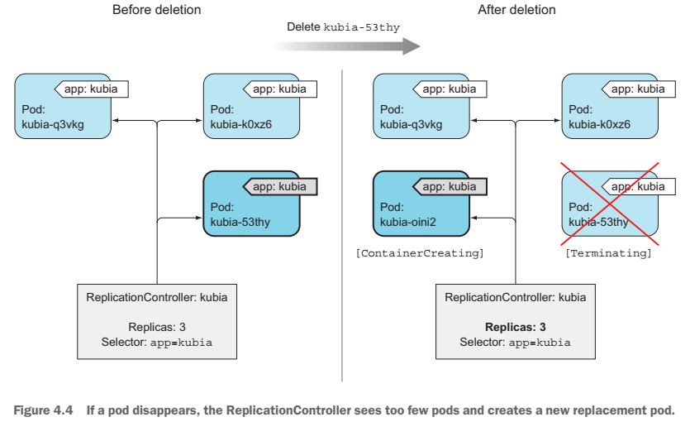

Slide 26
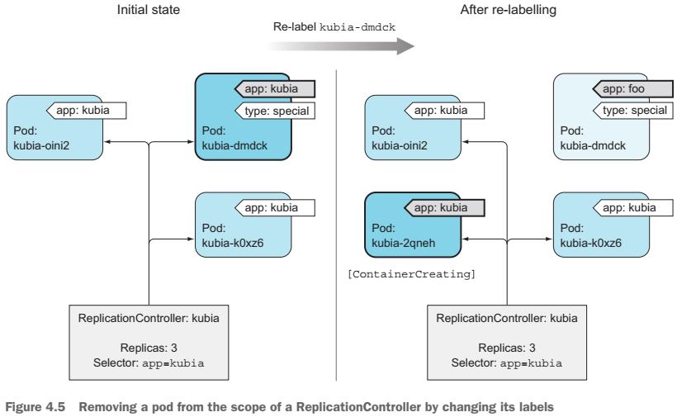

Slide 27
Services

Slide 28
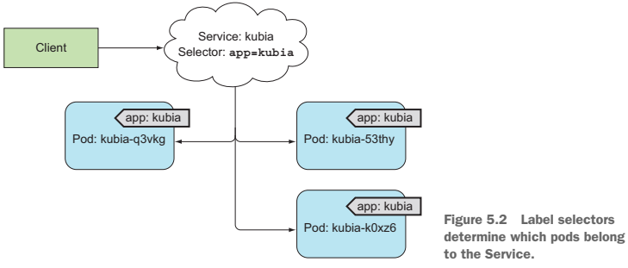

Slide 29
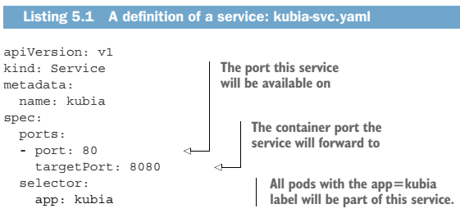

Slide 30
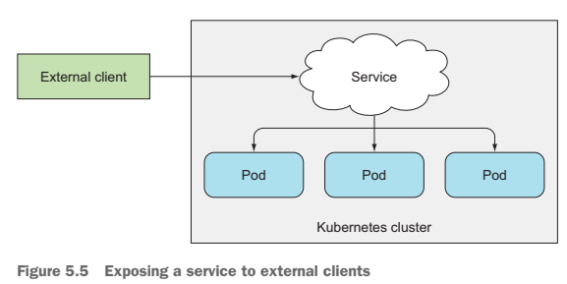

Slide 31
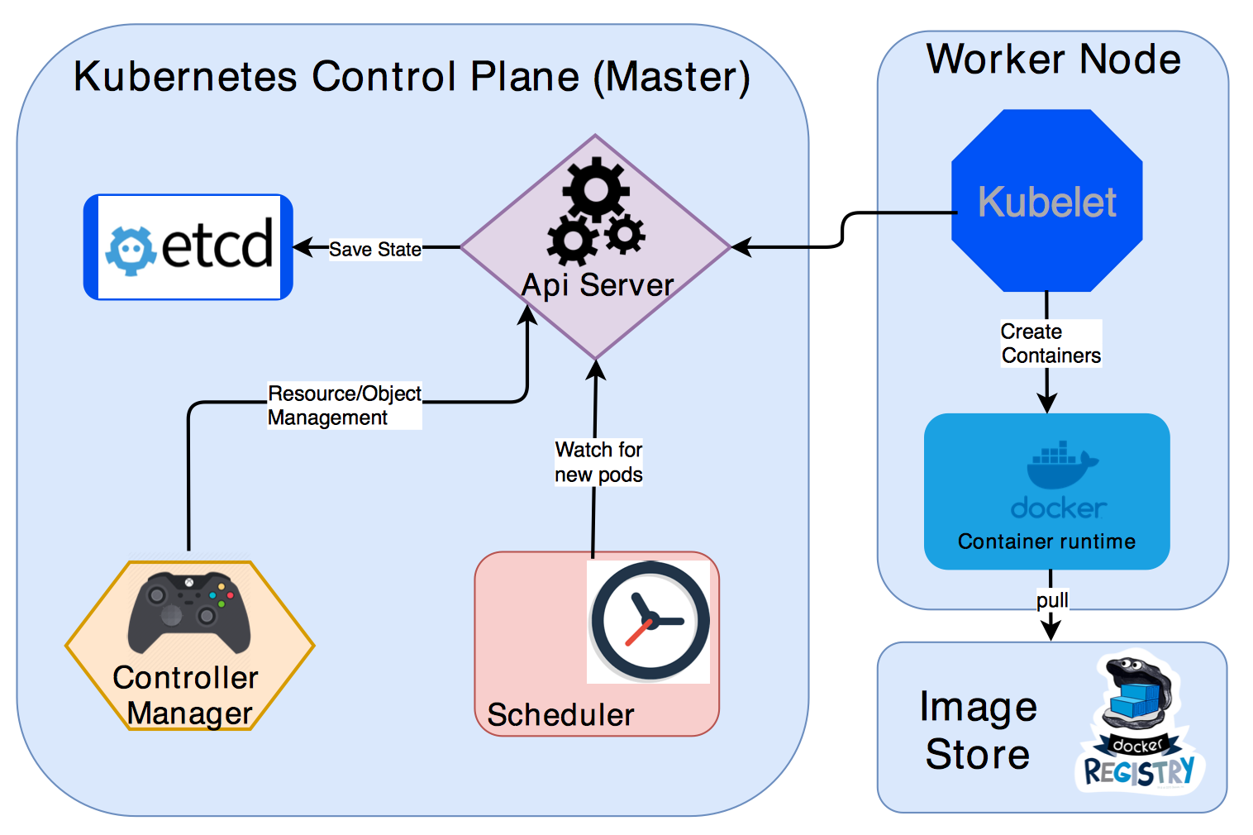
Kubernetes Architecture

Slide 32
Kubernetes namespaces
Provide for a scope of Kubernetes resource, carving up your cluster in smaller units
$ kubectl get ns
$ kubectl describe ns default
$kubectl create namespace test

Slide 33
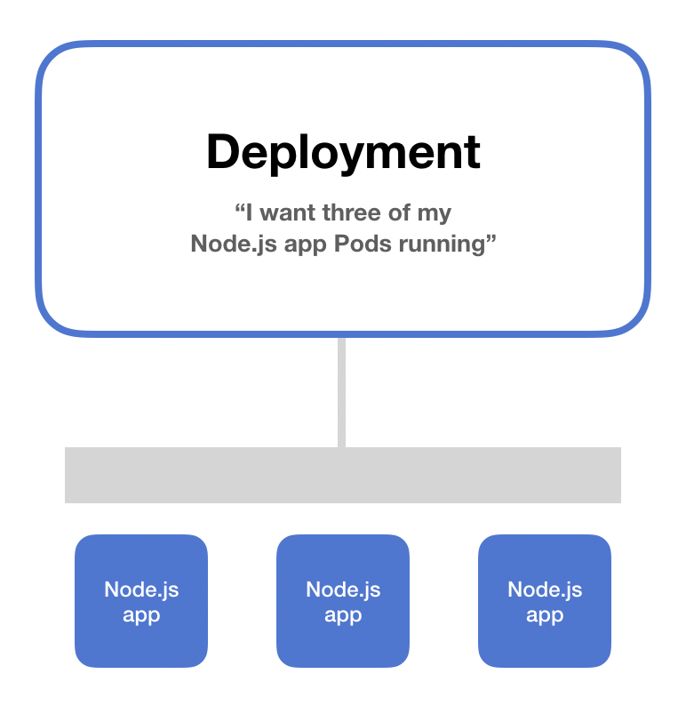
Kubernetes deployment
Everyone running applications on Kubernetes cluster uses a deployment.
It’s what you use to scale, roll out, and roll back versions of your applications.
With a deployment, you tell Kubernetes how many copies of a Pod you want running. The deployment takes care of everything else.

Slide 34
Service and Ingress
To consume your deployment, you will need to create ingress rules that expose your deployment to the external world.
Kubernetes Ingress is a resource to add rules for routing traffic from external sources to the services in the kubernetes cluster

Slide 35
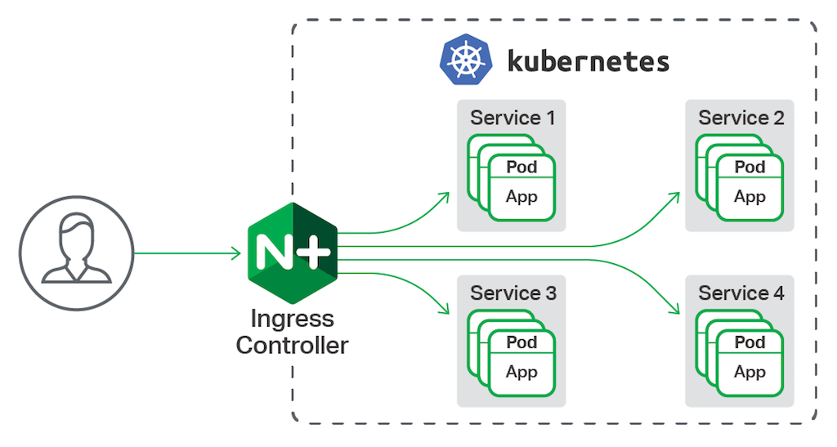
Service and Ingress
To confirm:
kubectl get pods -n ingress-nginx

Slide 36
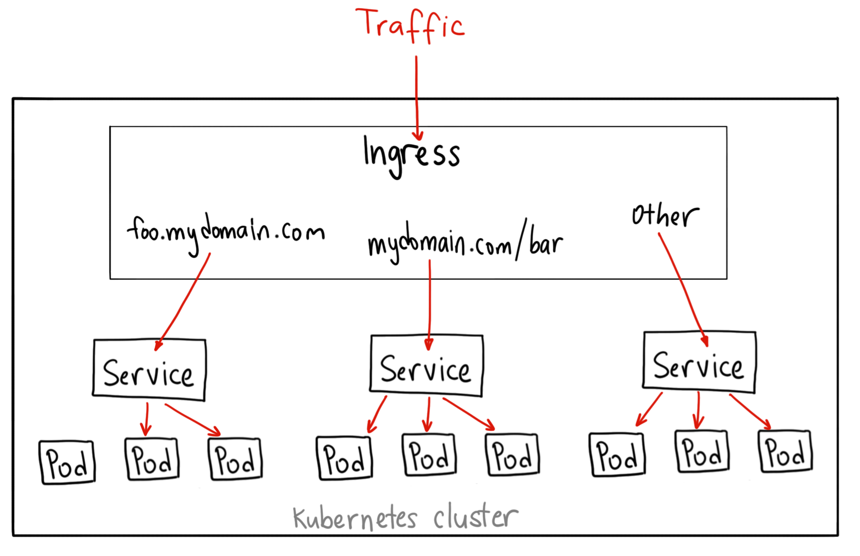
Service and Ingress

Slide 37
Thanks

